Slide 1


Slide 2
GOAL AND OBJECTIVES
To strengthen moral values in children enrolled at sankalp centres

Slide 3
1. Five universal human values –truth, righteousness, peace, love, non violence are directly linked to physical, intellectual, emotional psyche and spiritual facets of human personality
2. There is need and urgency to strength these values for a better and humane society
3. We, at Sankalp have decided to inculcate these values and ethics in children thru
3.a Moral Science Classes
3.b Covering Spiritual side of Mythological stories
3.c Habits pertaining cleanliness, hygiene and discipline
3.d Human Values such as honesty, brotherhood, respectfulness..
Inculcating values and ethics in children

Slide 4
ETHICS-A COMMON GROUND FOR ALL OF US
The future of the society depends on the children
Children with ethics and values will create a society free from social evils and crimes
It will reduce corruption, increase responsible behaviour thereby leading to better governance
Efforts to inculcate values and ethics in children improve not only the present condition but will also lay the foundation of a golden future
Keeping in mind the above, Sankalp Team has decided to impart moral values thru special classes
The first in the line wa organized at NIT Centre on 19th Feb 2016

Slide 5


Slide 6
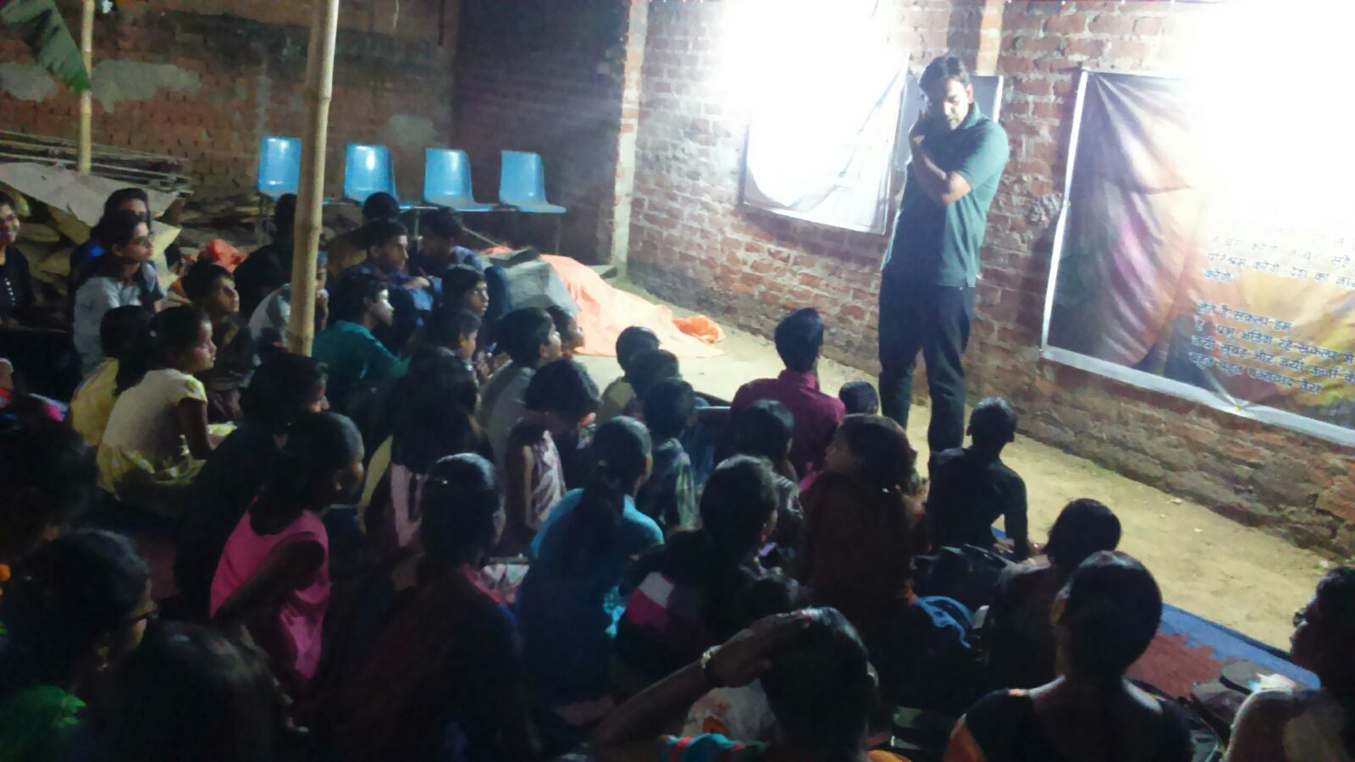
THE TEAM WITH A MISSION

Slide 7


Slide 8
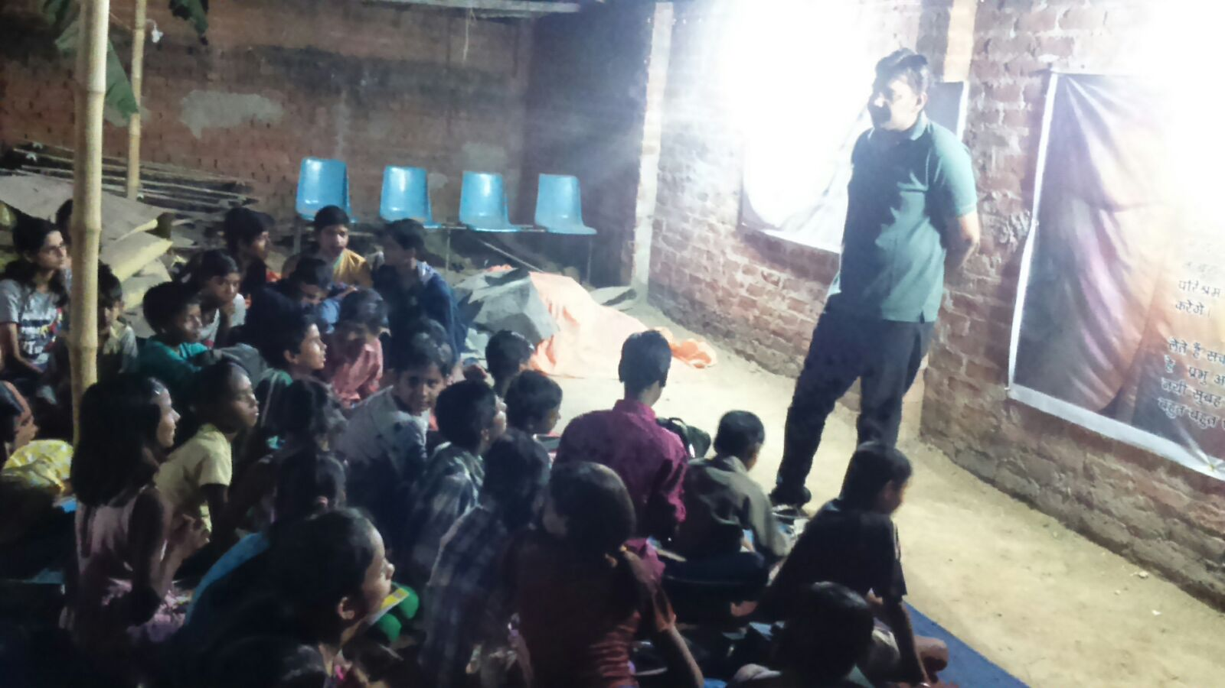
SANKALP TEAM LEADING FROM THE FRONT

Slide 9


Slide 10
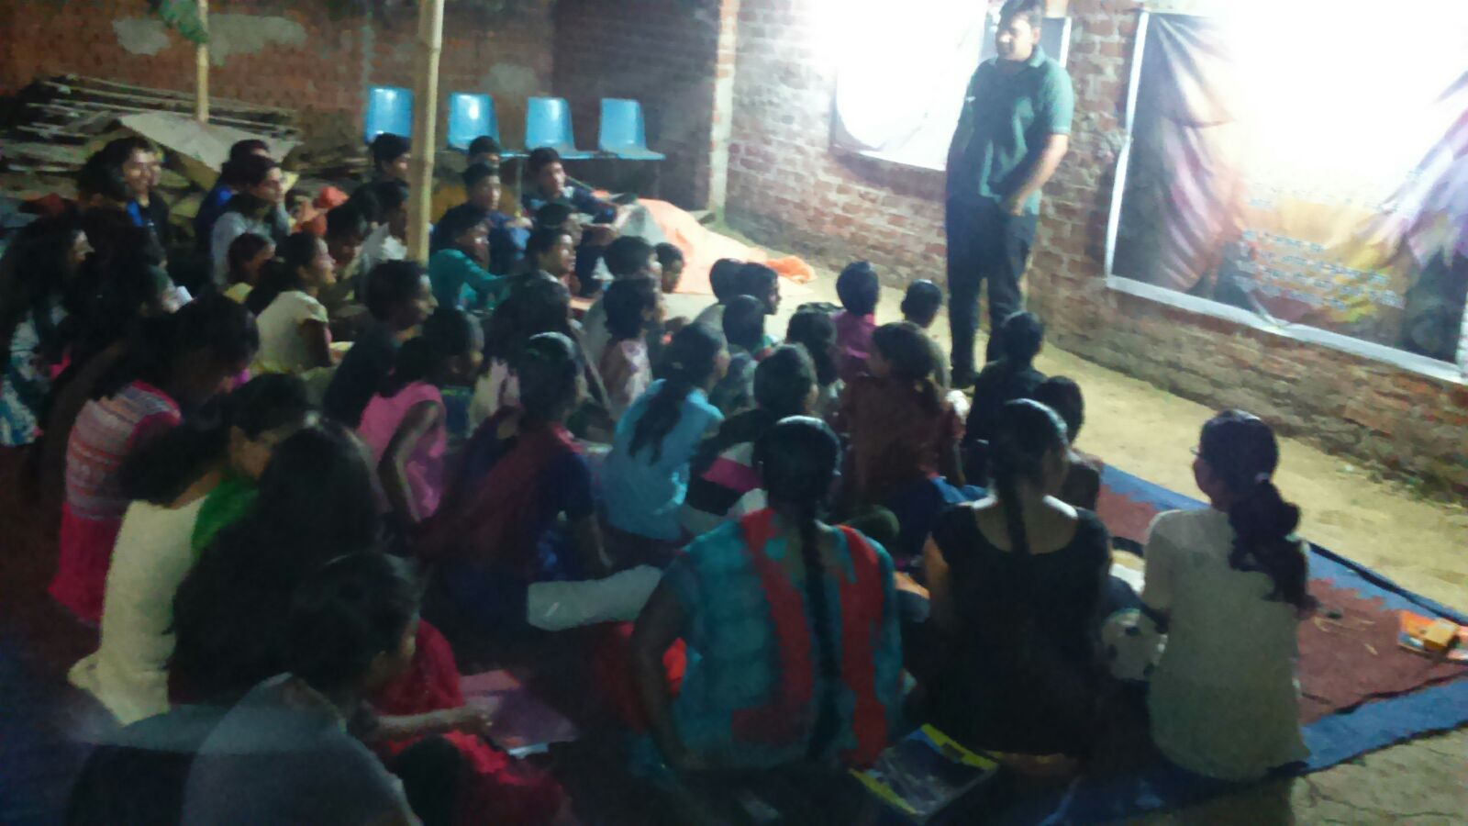
Words can do MIRACLES..........

Slide 11


Slide 12
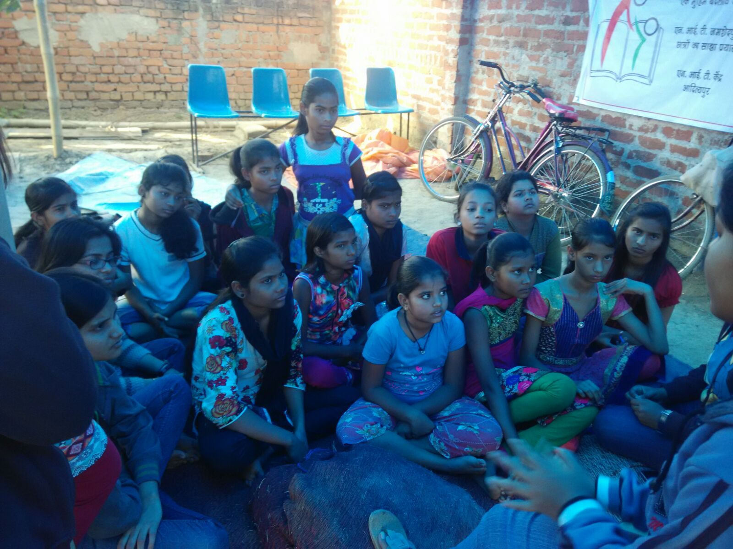
The future we hope to build !!!

Slide 13
"Change will not come if we wait for some other person or some other time. We are the ones we've been waiting for. We are the change that we seek.“

Slide 14
COME BE A PART OF THE JOURNEY
You can donate at any our centres by just making a call to Sankalp-A Pledge to Change volunteers.
All our centres run 6 days a week
You may donate books from
  Class 1-8- Course Text Books (Any Board)
  Story Books
  Unused stationery
  Any other items like bag, toys, uniforms etc.
Relevant Contact Nos. Are
  Subodh Kumar Das-9798756336
  Mayank Aggarwal -9031975746
  Suresh Pareek -7209632032
  Vikas Dixit -9472706225

Slide 15
ACCOUNT DETAILS FOR SUPPORT
Sankalp Account Details
  You can transfer funds online into our account:-
  “SANKALP” A/C No.-31114719936
  CIF No: 85757412911
  IFSC Code: SBIN0001882
  MICR Code: 831002004
  Branch code: (1882)
  Branch: SBI- RIT JAMSHEDPUR
    You may also visit our website and pay through online link available over it.
www.sankalpnitjamshedpur.org

Slide 16
“You have not lived today until you have done something for someone who can never repay you.”
www.sankalpnitjamshedpur.org

